Slide 1
PAW-VENTX
Residential Counterflow Ventilation

Slide 2
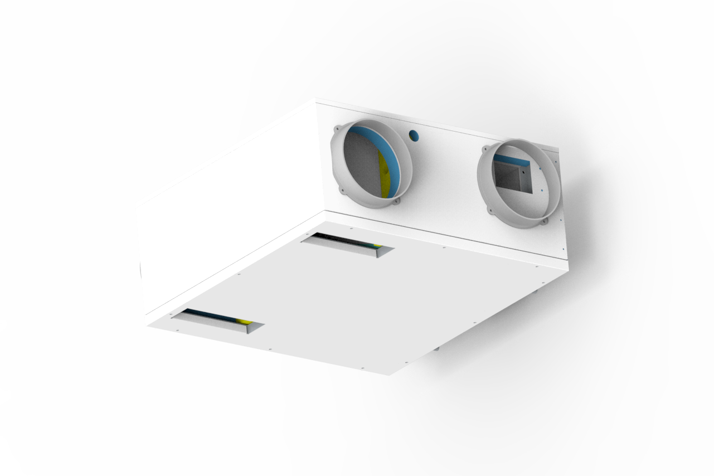
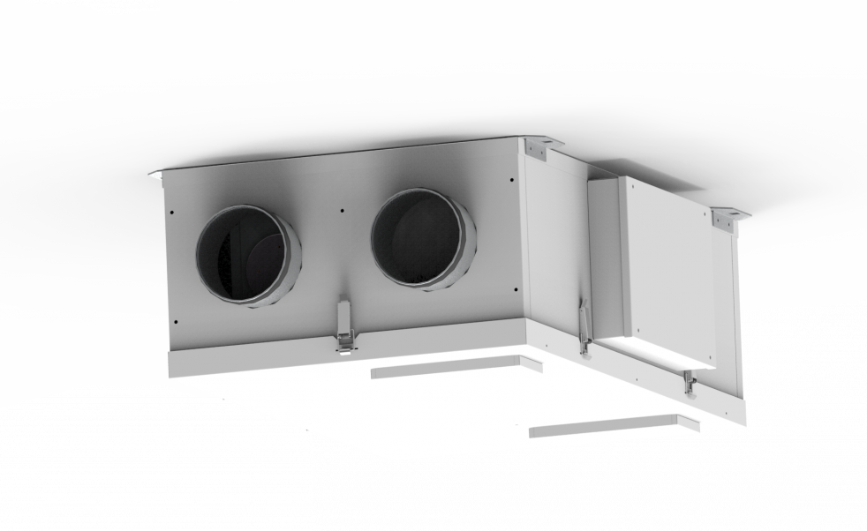
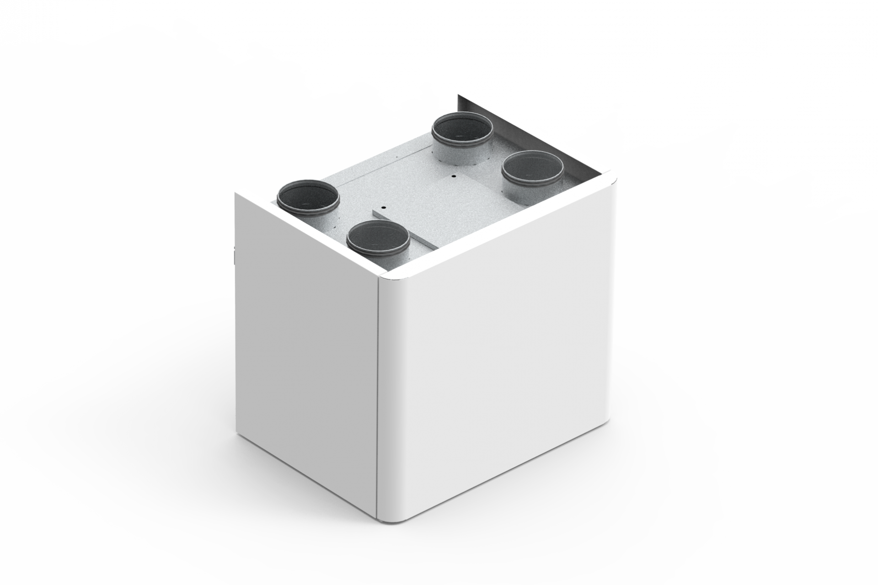
NEW PAW-VENTX Residential Counterflow Ventilation units
PAW-VENTX...
 | 20/30/40 V | 20/30/40 H | 10/15 Z
Install type: | Vertical | Horizonal | Vertical / Horizontal
Airflow range | 112 – 375 m³ | 112 – 375 m³ | 72 – 133 m³
Widened application range now supported
Complements our existing residential solutions line-up
Suitable for a variety of installation requirements
Price-competitive solution

Slide 3
Topics for today’s webinar
Why ventilation is important:
Political drivers (EU direction, EPBD)
Energetic aspects
Health and comfort (disease prevention, air quality etc.)
Building Protection
How to ventilate:
Ventilation theory
System types (natural, mechanical and heat recovery)
NEW VENTX HRV units

Slide 4
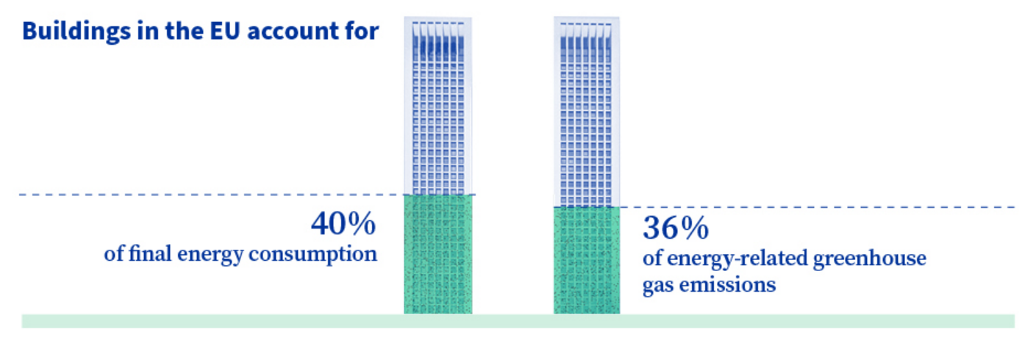
Why Ventilation
“In the European Union, buildings alone account for as much as 40% of total energy consumption. And are also responsible for 36% of direct/indirect greenhouse gas emissions related to energy consumption.” ⁽¹⁾
With these conditions it is necessary to reduce building emissions to combat climate change and the greenhouse effect
1. Source: European Council

Slide 5
Why Ventilation
European Performance of Buildings Directive (EPBD)
To boost energy performance of buildings, the EU has established a legislative framework that includes the Energy Performance of Buildings Directive 2010/31/EU and the Energy Efficiency Directive 2012/27/EU.
Both directives were amended in 2018 and 2019, as part of the “Clean Energy package”
In 2020, proposal to revise the EPBD to support the Renovation Wave Strategy – which aims to double the energy renovation rate by 2030
“The EPBD is a constantly evolving instrument and aims - in time - to phase out buildings with inadequate energy performance.”
Alleviate energy poverty
Health benefits
Improved quality of life
Create ‘green’ jobs
1. Source: European Council

Slide 6
Why Ventilation
In a residential property, the energy lost through ventilation accounts for one of the greatest factors
Source: Open University

Slide 7
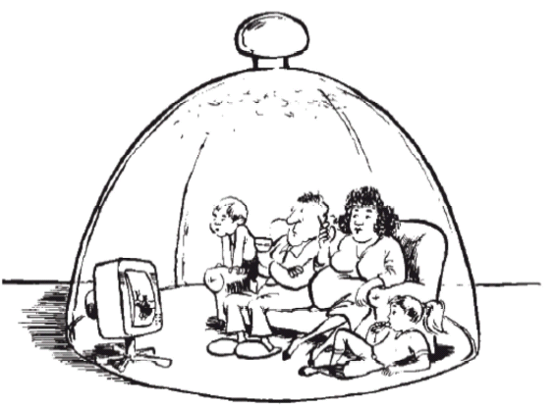
Why Ventilation
Increased standards for insulation have also led to
ventilation decreasing, resulting in poorer indoor air quality (IAQ) levels.
A very well insulated house, means a very airtight house.
On average, we spend 90% of our time indoors.
This means the impact of poor IAQ is very high.

Slide 8
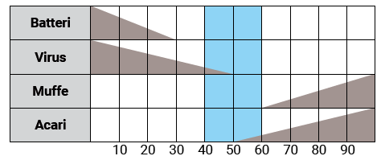
Why Ventilation
Ventilation systems help to manage humidity levels by removing moist air from the building
microorganism proliferation
ideal area for human health
Bacteria
Virus
Mould
Mites
Humidity (%)
Source: ASHRAE Trans. 91 – 1B (1985)

Slide 9
Why Ventilation
CO2 levels should be controlled to maintain health and well-being
Desirable
1000 ppm
1200 ppm
Acceptable
Poor
1500 ppm
> 5000 ppm
Dangerous

Slide 10
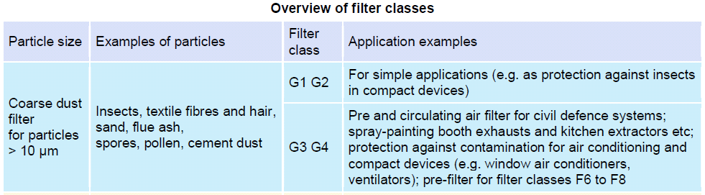
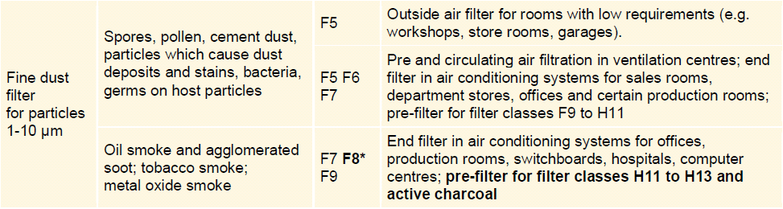
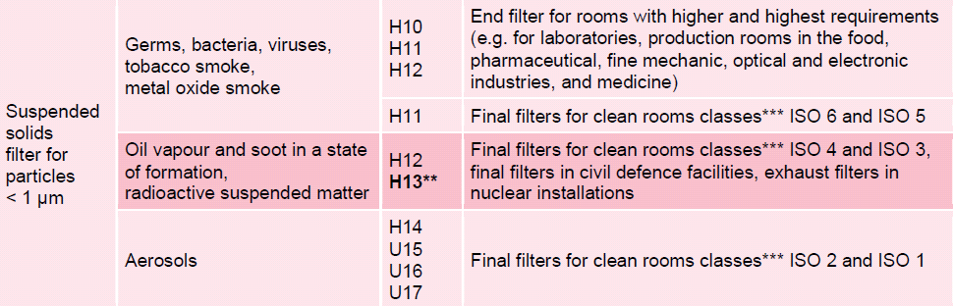
Why Ventilation
Old Filtration class: EN 779
Rated air filters from G1-F9
NEW Filtration class: ISO 16890
Based on particulate matter groups

Slide 11

Why Ventilation
ePM1 0.3 – 1.0 µm | ePM2.5 0.3 – 2.5 µm | eMP10 0.3 – 10 µm | Coarse
ePM1 95 % | ePM2.5 95 % | ePM10 95 % | Coarse 95 %
ePM1 90 % | ePM2.5 90 % | ePM10 90 % | ISO Coarse
ePM1 85 % | ePM2.5 85 % | ePM10 85 %
ePM1 80 % | ePM2.5 80 % | ePM10 80 %
ePM1 75 % | ePM2.5 75 % | ePM10 75 %
ePM1 70 % | ePM2.5 70 % | ePM10 70 %
↓ ePM1 50 % | ↓ ePM2.5 50 % | ↓ ePM10 50 % | ↓ Coarse 5%
Example A:
This filter collects:
42 % of the PM1 fraction
66 % of the PM2 fraction
70 % of the PM3 fraction
Therefore, it is assigned ePM2 65 %
Example B:
This filter collects:
72 % of the PM1 fraction
76 % of the PM2 fraction
90 % of the PM3 fraction
Therefore, it is assigned ePM1 70 %

Slide 12
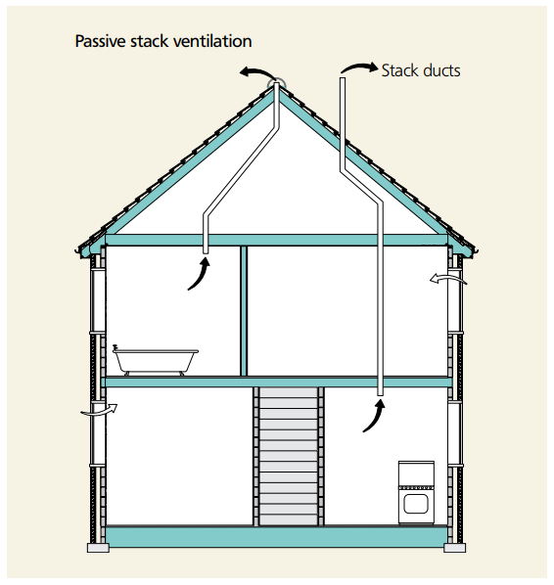
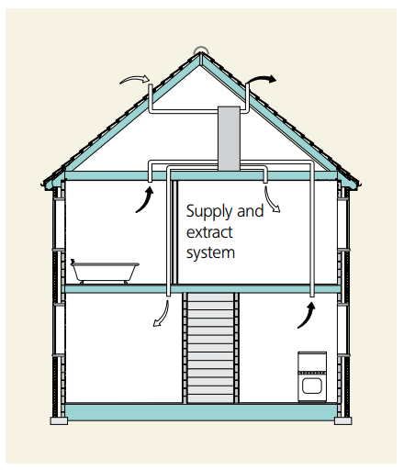
How to Ventilate
Residential Ventilation Systems
Natural Ventilation
Horizontal transverse ventilation
Shaft ventilation
Mechanical Ventilation
Extract ventilation
Supply and extract ventilation
Hybrid Ventilation
Natural + extract ventilation
Natural + S/E ventilation
Image Source: Energy Saving Trust

Slide 13
How to Ventilate
Image Source: Energy Saving Trust

Slide 14
How to Ventilate
Natural Ventilation
Mechnical Ventilation
Airflow is not controlled
Controlled airflow
Heat recovery not possible
Sensible / enthalpic heat recovery
Unstable air temperatures
Thermal comfort
Free cooling with summer bypass
Free cooling
Fan power consumption
No running cost

Slide 15
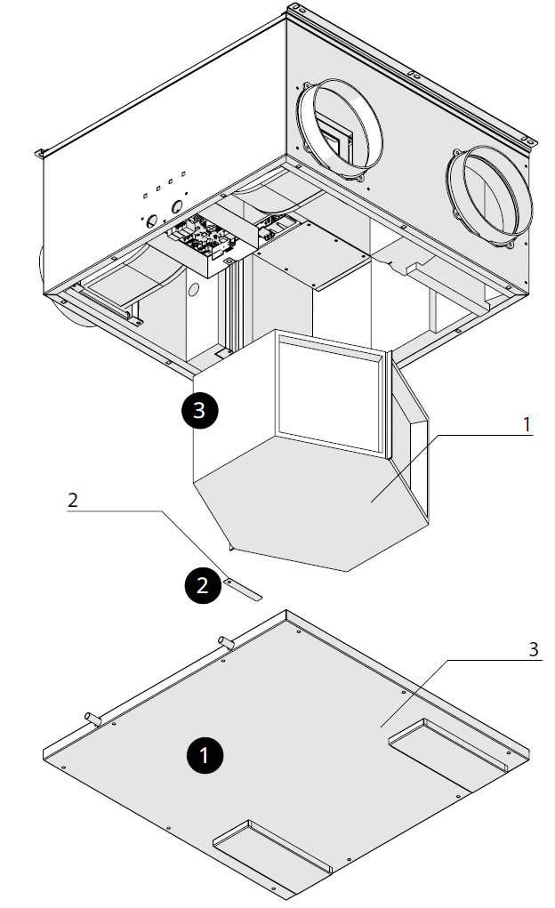
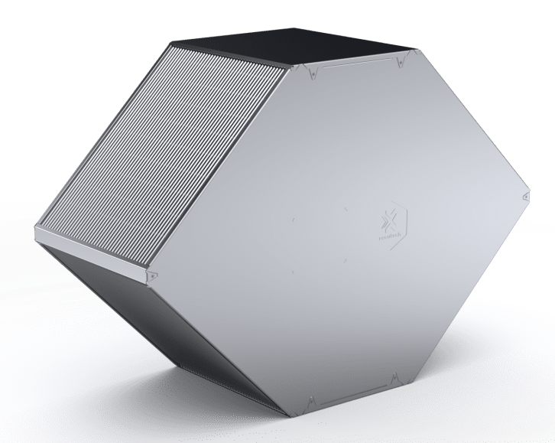
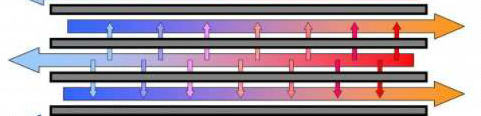
How to ventilate
A recuperative heat exchanger is an enclosure with a series if plates (ribs), which allow extracted air to pass over incoming fresh air. The heated fresh air can then be used as supply air for the building
Extract
Fresh
Supply
Exhaust
Exhaust
Extract
Fresh
Supply

Slide 16
How to Ventilate
Counter-flow
heat exchanger
Cross-flow
heat exchanger
Fresh
Extract
Fresh
Supply
Exhaust
Extract
Exhaust
Supply
Fresh
Extract
Cross counter-flow
heat exchanger
Exhaust
Supply

Slide 17
How to Ventilate
Cross-flow
heat exchanger
Cross counter-flow
heat exchanger
Fresh
-12 °C
Extract
22 °C
Fresh
-12 °C
Extract
22 °C
Exhaust
-9 °C
Supply
19 °C
Exhaust
-2 °C
Supply
12 °C

Slide 18
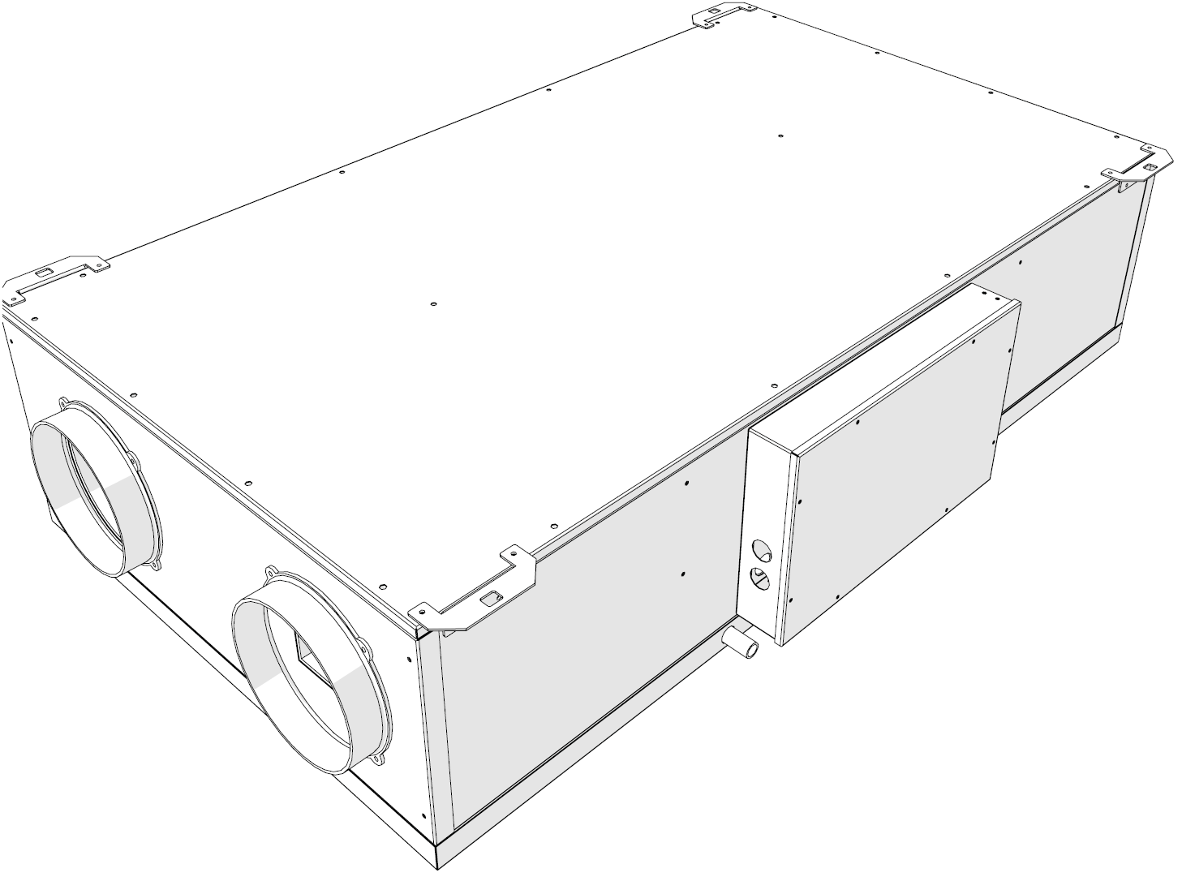
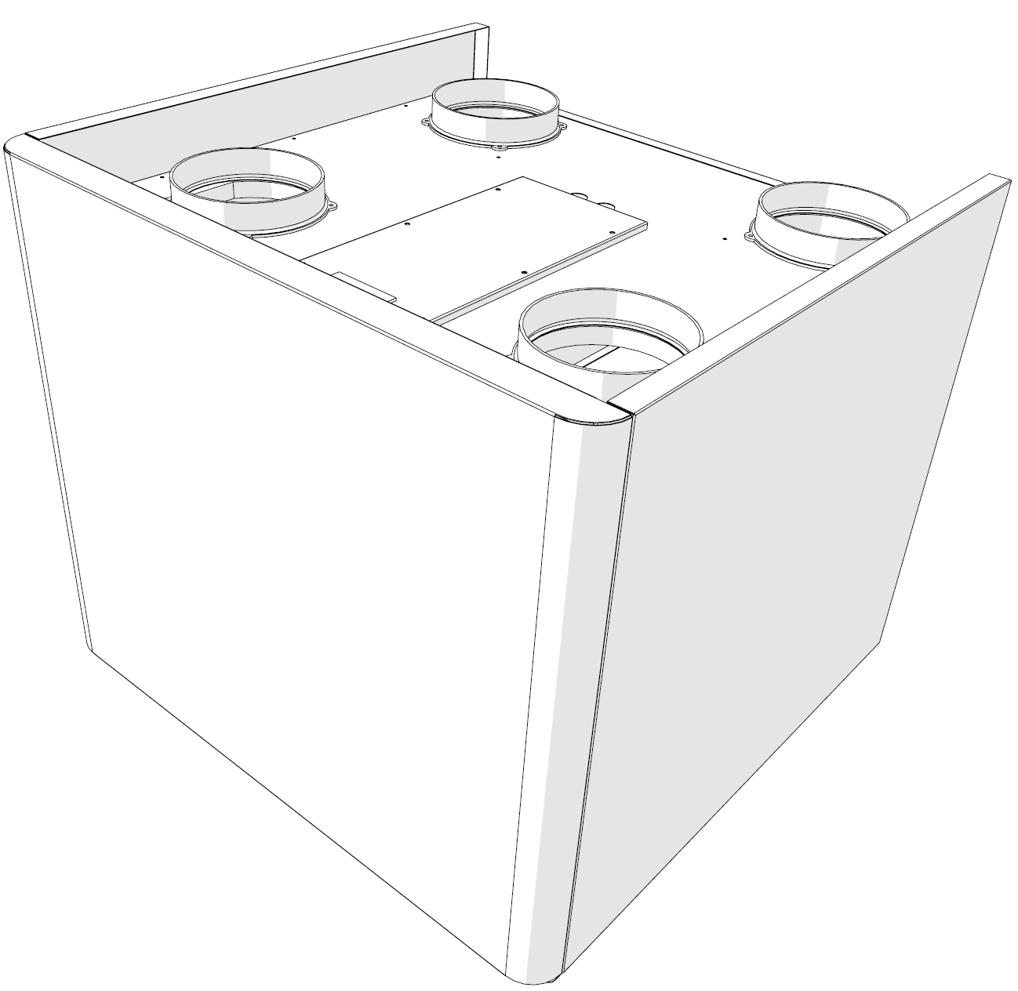
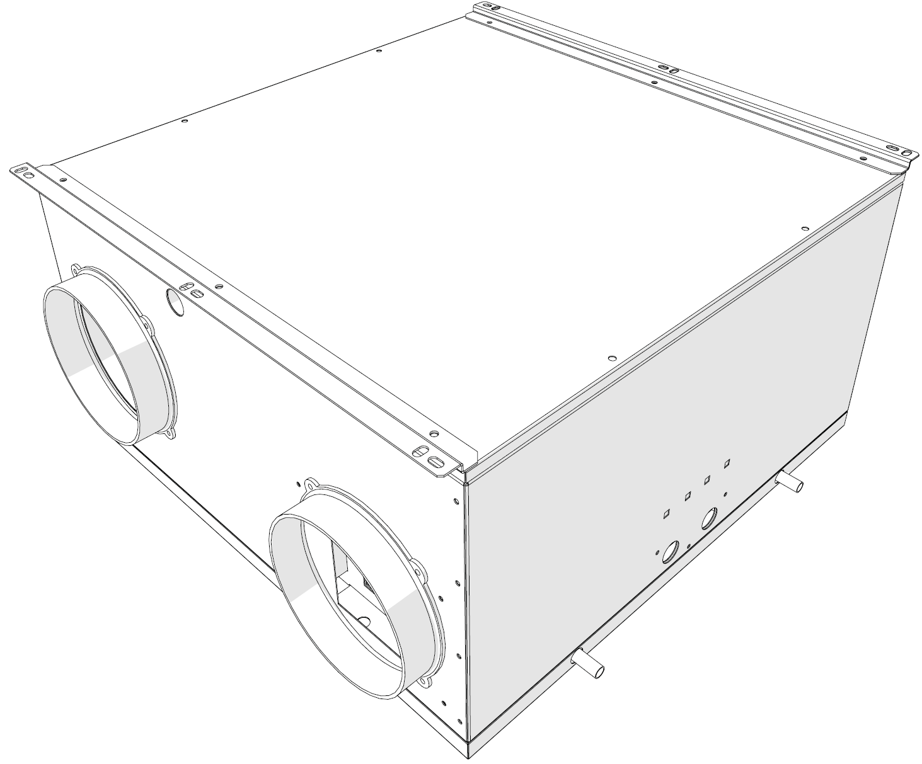
NEW PAW-VENTX Range
Horizontal mounting unit (H)
Horizontal mounting (possible for some false ceilings)
Suitable for single family houses, with nominal air flow rates up to 350 m³/h
Easily accessible lower panel for maintenance and inspection
Vertical mounting unit (V)
Vertical mounting (typically in a technical room)
Suitable for single family houses, with nominal air flow rates up to 350 m³/h
Easily accessible front panel for maintenance and inspection
Universal mounting compact unit (Z)
Universal mounting (horizontal or vertical)
Suitable for small and medium size apartments, with nominal air flow up to 200 m³/h

Slide 19
NEW PAW-VENTX Range
PAW-VENTX...
 | 20/30/40 V | 20/30/40 H | 10/15 Z
Install type: | Vertical | Horizonal | Vertical / Horizontal
Airflow range | 112 – 375 m³ | 112 – 375 m³ | 72 – 133 m³
91 m³/h
292 m³/h
380 m³/h
Airflow Range

Slide 20
NEW PAW-VENTX Range
Structure: self-supporting sheet metal frame, interior in high density EPS 30 kg/m³ and polyethylene foam. Carpentry and internal plugging in thick galvanised sheet metal.
Heat exchanger: counter-current type. Sensible version in polypropylene, enthalpic version with breathable membranes⁽¹⁾.
Brushless fans: DC fans regulated by inverters allow high levels of comfort and energy efficiency with constant flow function.
Filters: EPM1 filter on fresh air and extract air with low pressure drop. Easily removable for routine maintenance.
1. Not available at present.

Slide 21
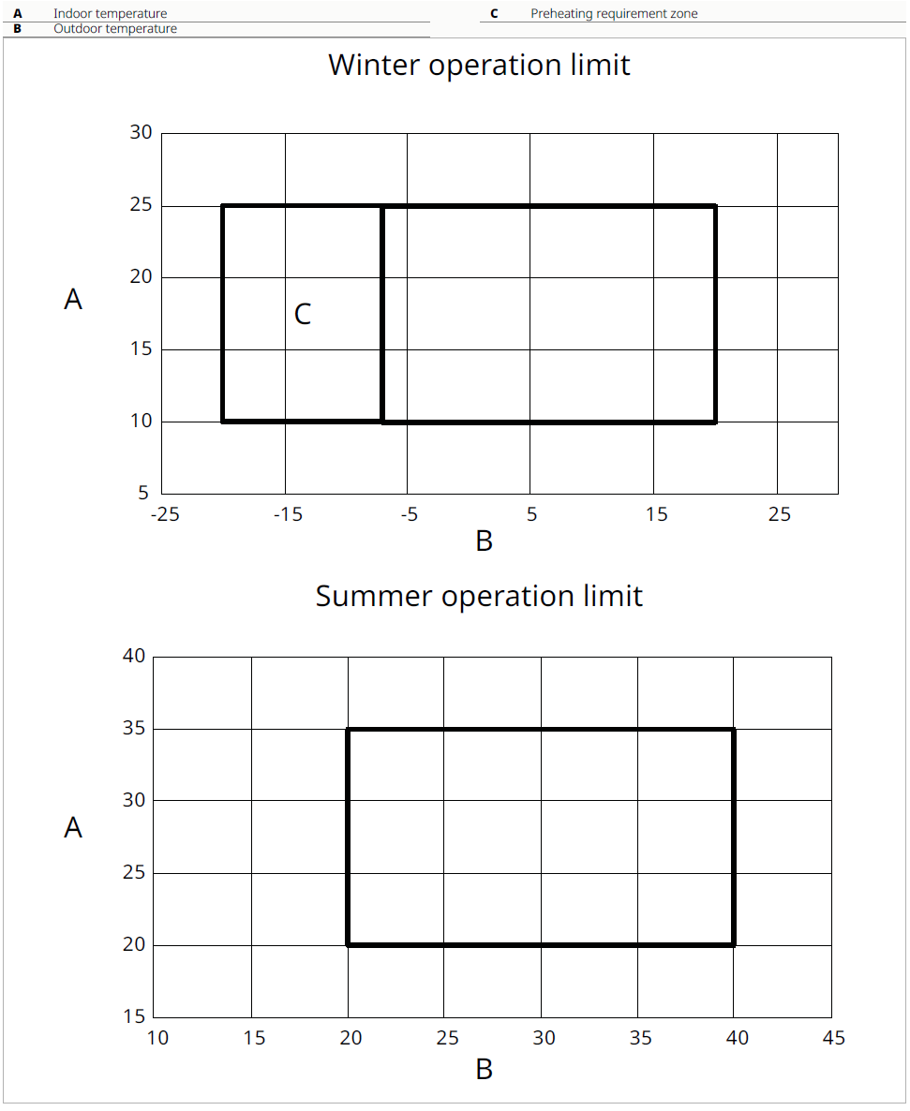
NEW PAW-VENTX Range
Winter operation limit
Summer operation limit
Indoor
temperature
(°C)
Indoor
temperature
(°C)
A
Outoor temperature (°C)
Outoor temperature (°C)
A: Pre-heating required below -7 °C
PAW-VEN-HTR05: Electrical duct heater 0.5 kW
PAW-VEN-HTR10: Electrical duct heater 1.0 kW

Slide 22
NEW PAW-VENTX Range
Remote control available in black and white options:
PAW-VEN-CNTRLB
PAW-VEN-CNTRLW
Both contain built-in VOC and humidity sensors as standard

Slide 23



NEW PAW-VENTX Range
All seasons
Heat Recovery Ventilation
Control of IAQ
Filtering outdoor air
Control of internal equilibrium pressure
Winter
Anti-freezing protocol
Control of internal humidity, increase ventilation ratio
Summer
Free cooling or summer bypass
Control of internal humidity, decrease ventilation ratio

Slide 24

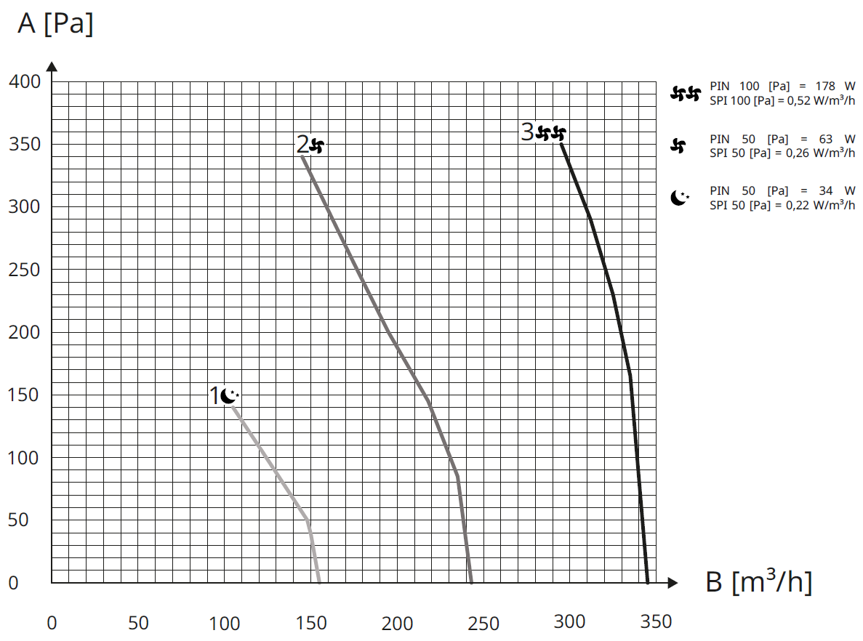



NEW PAW-VENTX Range
Makes ventilation speed adjustment fully automatically according to IAQ values is RH %
PAW-VENTX40H Fan Performance Curve
Static pressure
Allows you to set the minimum ventilation speed
Allows you to set the rated ventilation speed / Allows you to set the desired humidity value
Allows you to set the maximum ventilation speed
Air volume

Slide 25
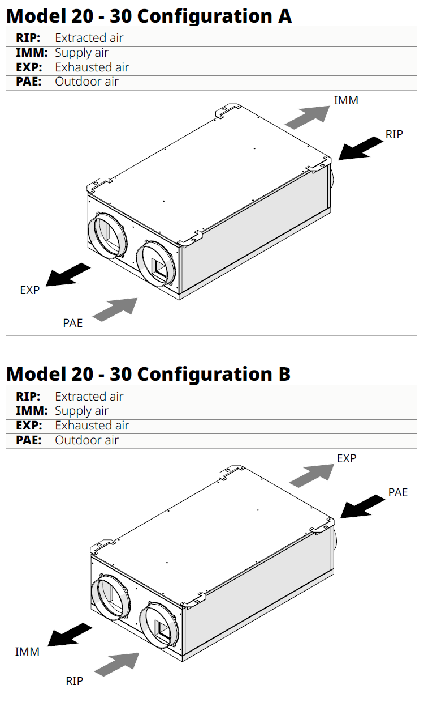
NEW PAW-VENTX Range
Each unit can be configured in one of two ways (A/B), depending on the installation
A: Factory configuration | B: Modification on-site

Slide 26
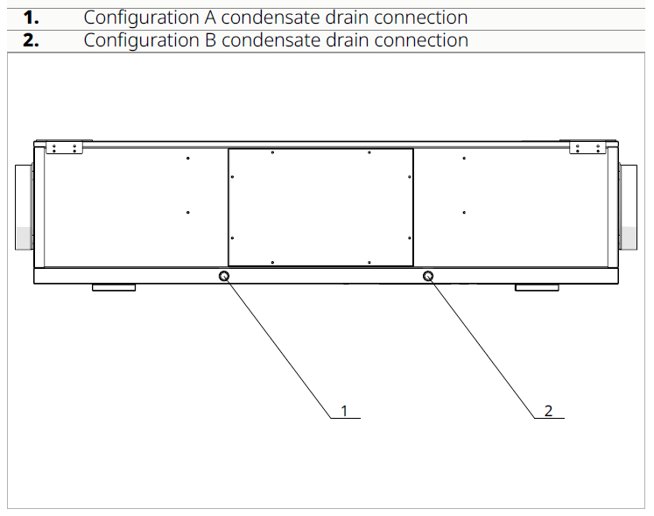
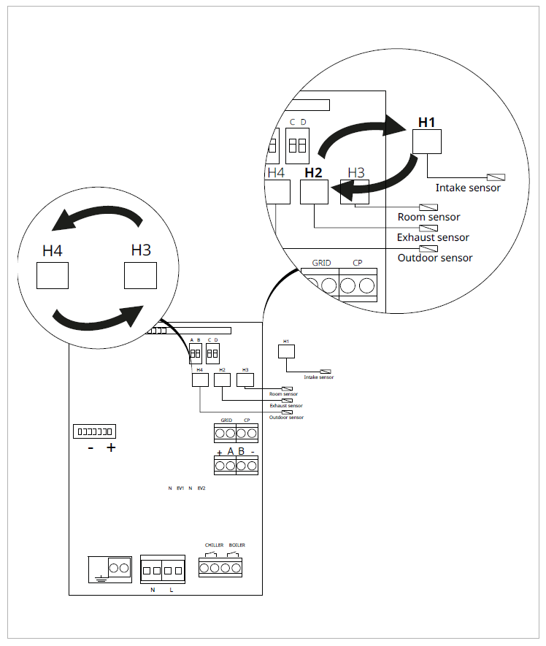
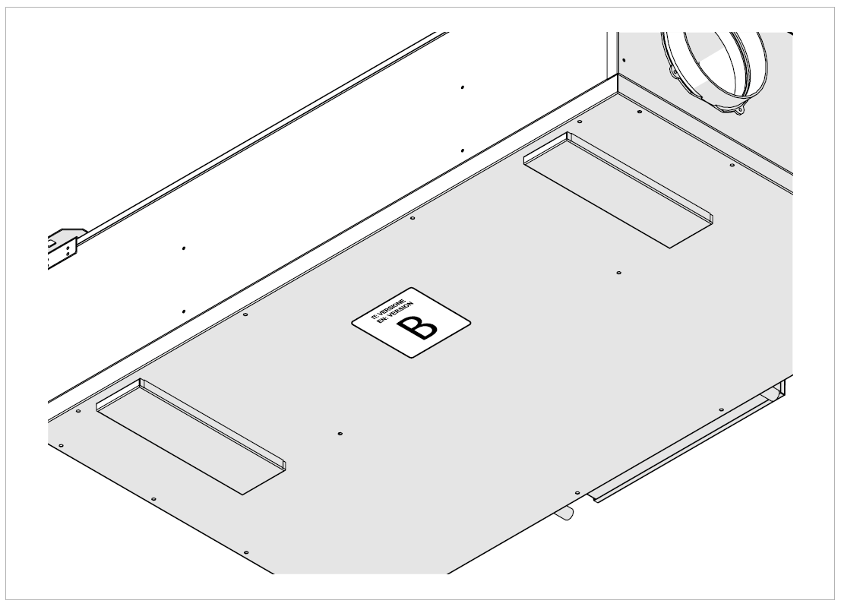
NEW PAW-VENTX Range
If configuration B is chosen, alternate drain connections, sensor terminals and label must be used

Slide 27
PAW-VENTX Range
Specific Power Input:
Specific Power Input (SPI) is a parameter that quantifies system energy efficiency. A measure of electric power required relative to the amount of air moved [kW/(m³/h)].
Specific Fan Power:
Specific Fan Power (SFP) is a parameter that quantifies fan energy efficiency. A measure of electric power required relative to the amount of air moved [kW/(m³/s)].

Slide 28
PAW-VENTX Range
 |  |  |  |  | CLASS A | SPI < 0.28
 | Max. m³/h | Pa | Ref. m³/h | Pa | SEC Class | SPI W/m3/h
VENTX10Z | 130 | 100 | 91 | 50 | A | 0.242
VENTX15Z | 210 | 100 | 147 | 50 | A | 0.313
VENTX20H | 155 | 100 | 109 | 50 | A | 0.276
VENTX20V | 170 | 100 | 112 | 50 | A | 0.277
VENTX30H | 300 | 100 | 210 | 50 | A | 0.271
VENTX30V | 300 | 100 | 210 | 50 | A | 0.276
VENTX40H | 340 | 100 | 238 | 50 | A | 0.265
VENTX40V | 380 | 100 | 266 | 50 | A | 0.256
All units will have a be in Energy Class A
We comply with Danish Regulation DK BR18

Slide 29

PAW-VENTX Residential Counterflow Ventilation
Price competitive product range which delivers great value
In-line with the global direction of building development and climate control strategies
Compliments available range of Panasonic solutions
Suitable for a wide range of applications; highly versatile range which is installation friendly

Slide 31
NEW PAW-VENTX Range
PAW- |  | VENTX10Z | VENTX15Z | VENTX20H | VENTX20V | VENTX30H | VENTX30V | VENTX40H | VENTX40V
Air flow (Nom/Max) | M³/h | 91 / 130 | 147 / 210 | 109 / 155 | 112 / 170 | 210 / 300 | 210 / 300 | 238 / 340 | 266 / 380
Static pressure (nom/max) | Pa | 50 / 100 | 50 / 100 | 50 / 100 | 50 / 100 | 50 / 100 | 50 / 100 | 50 / 100 | 50 / 100
Type of HEX |  | Counter flow HRV / Sensible
Recovery Efficiency | % | 87 | 85 | 86 | 86 | 85 | 86 | 89 | 87
Energy class |  | A | A | A | A | A | A | A | A
Power supply | V/Hz | 230 / 50 | 230 / 50 | 230 / 50 | 230 / 50 | 230 / 50 | 230 / 50 | 230 / 50 | 230 / 50
Power consumption (nom) | W | 80 | 140 | 110 | 110 | 180 | 180 | 350 | 350
Sound power LWA | Db(A) | 48 | 51 | 49 | 48 | 50 | 50 | 52 | 51

Slide 32
NEW PAW-VENTX Range
Model Code |  | VENTX10Z | VENTX15Z | VENTX20H | VENTX20V | VENTX30H | VENTX30V | VENTX40H | VENTX40V
Dimensions | mm | 580 x 580 x 255 | 580 x 580 x 255 | 800 x 480 x 260 | 625 x 430 x 510 | 795 x 600 x 295 | 785 x 575 x 590 | 1150 x 650 x 290 | 785 x 735 x 590
Weight | kg | 19 | 19 | 25 | 32 | 300 | 38 | 38 | 42
Mounting position |  | Hor / Ver | Hor / Ver | Horizontal | Vertical | Horizontal | Vertical | Horizontal | Vertical
Filter class |  | ePMI 80% | ePMI 80% | ePMI 80% | ePMI 80% | ePMI 70% | ePMI 70% | ePMI 70% | ePMI 70%
Duct connections | mm | 160 | 160 | 160 | 160 | 160 | 160 | 160 | 160

